Slide 1
Econ 100 Principles of Economics
Lecture 20
May 17

Slide 2
Inflation

Slide 3
How to calculate inflation?
Find the Prices: Find the prices of each of the goods and services in the basket for each point in time.
Compute the Basket’s Cost: Use the data on prices to calculate the cost of the basket of goods and services at different times.
Choose a Base Year and Compute the Index:
Choose a year as the base year, making it the benchmark against which other years are compared.
For Turkey currently the base year is 2003
To compute the index for any given year
divide the cost of the basket in that year by the cost in the base year
then multiply by 100.
Compute the inflation rate: The inflation rate is the percentage change in the price index from the preceding period.

Slide 4
Inflation vs GDP deflator

Slide 5
Two measures of prices
Notes:
This figure shows the inflation rate – the percentage change in the level of prices – as measured by the GDP deflator and the Consumer Price Index using quarterly data from the U.S. economy.
Notice that the two measures of inflation generally move together. There are a few years when they diverge a bit. The reasons for this are on the next slide.
Source:
GDP deflator – Bureau of Economic Analysis, U.S. Dept of Commerce
CPI – Bureau of Labor Statistics, U.S. Dept of Labor
I obtained both from the Federal Reserve Bank of St. Louis “Fred” database:
http://research.stlouisfed.org/fred2/

Slide 6
Contrasting the CPI and GDP Deflator
Imported consumer goods:
included in CPI
excluded from GDP deflator
Capital goods:
excluded from CPI
included in GDP deflator (if produced domestically)
The basket:
CPI uses fixed basket
GDP deflator uses basket of currently produced goods & services
This matters if different prices are changing by different amounts.
CHAPTER 24 MEASURING THE COST OF LIVING

Slide 7
A C T I V E L E A R N I N G 2: CPI vs. GDP deflator
In each scenario, determine the effects on the CPI and the GDP deflator.
A. Starbucks raises the price of Frappuccinos.
B. Caterpillar raises the price of the industrial tractors it manufactures at its Illinois factory.
C. Armani raises the price of the Italian jeans it sells in the U.S.
59
Notes:
If you wish to make this more challenging, move the preceding slide so that it appears immediately after the answers to this exercise.
If you are outside the U.S., please make the following changes:
in (b), change the example to “A local manufacturer raises the price on industrial tractors it produces.”
in (c), change “U.S.” to your country’s name, unless your country’s name is Italy. (If your country is Italy, then change the example to something involving an imported consumer good.)

Slide 8
A C T I V E L E A R N I N G 2: Answers
A. Starbucks raises the price of Frappuccinos.
The CPI and GDP deflator both rise.
B. Caterpillar raises the price of the industrial tractors it manufactures at its Illinois factory.
The GDP deflator rises, the CPI does not.
C. Armani raises the price of the Italian jeans it sells in the U.S.
The CPI rises, the GDP deflator does not.
60
Notes:
Explanations:
A. Frappuccinos are produced in the U.S., so their prices are part of the GDP deflator. They are purchased by consumers, so their prices are part of the CPI. Hence, an increase in the price of Frappuccinos causes both the CPI and GDP deflator to increase.
B. Since the tractors are produced here in the U.S., the price increase causes the GDP deflator to rise. However, industrial tractors are a capital good, not a consumer good, so the CPI is unaffected.
C. Italian jeans appear in the U.S. consumer’s shopping basket, and hence the increase in their price causes the CPI to rise. However, the GDP deflator is unchanged, because it only includes prices of domestically produced goods, and excludes the prices of imports.

Slide 9
Comparing prices: now and then
University tuition rates, footballers’ transfer fees, bread, etc

Slide 10
http://www.chevroletclubtr.com/benzin-fiyatlari-10-yilda-yuzde-534-artti-t551.0.html
Benzin fiyatları
Due to the increases both in exchange rate and crude oil the price of fuel increased to 3,68 TL in 2010 from 0,58 TL in 2000
6 March 2013
With 10 kuruş decrease in price of 95 ve 97 octane unleaded gasoline, the price of gasoline became 4,74-4,76 TL in İstanbul and İzmir

Slide 11


http://hurarsiv.hurriyet.com.tr/goster/haber.aspx?id=-86653 19.06.1999
In 1991 Tanju Çolak had a deal with GS for 3,5 billion for 2 years. However since prices ared fixed to the exchange rate in 5 years, the price made a huge increase. In 1996 when Rüştü Rençber renewed his contract with Fenerbahçe he got 100 billion.

Slide 12
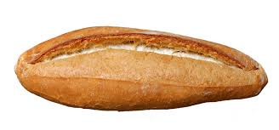
Daily Bread
1970 | 620 gr | 1 Lira
1980 | 480 gr | 7,5 Lira
1990 | 320gr | 1000 Lira
2000 | 200gr | 100,000 Lira
2010 | 300gr | 50 krş
2012 | 250gr | 50 krş

Slide 13
Koç Üniversity tuition rate
1998
6,500 USD . (EXCHANGE RATE 1,8)
2012-13
40,000 TL

Slide 14
We start with the footballers

Slide 15
Rüştü Reçber
100 billion TL in 1996
Let’s write this out
100,000,000,000 TL
Rüştü’s 100 billion without the 6 zeros

Slide 16
http://arsiv.ntvmsnbc.com/news/254830.asp?cp1=1
28 Ocak 2004— Drop out 6 zeros and new Turkish Lira in 1 Ocak with the approval of TBMM

Slide 17
Rüştü Reçber
100 billion TL in 1996
Let’s write this out
100,000,000,000 TL
Rüştü’s 100 billion without the 6 zeros
100,000 TL

Slide 18
Rüştü Reçber
Rüştü’s 100 billion without the 6 zeros is
100,000 TL
How much is 100,000TL in 1996 worth
in current (2013) prices?
We need the value of CPI in 1996 and in
2013.

Slide 19
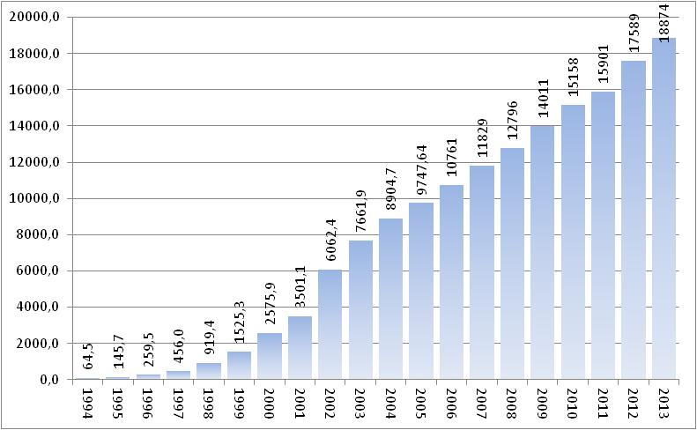
1994 Based Consumer Price Index Numbers, 1994-2006. The index after January 2006 are derived using the monthly rate of change in 2003=100 consumer price index.

Slide 20
Rüştü Reçber
Rüştü’s 100 billion without the 6 zeros is
100,000 TL
How much is this in current (2013) prices?
CPI January 1996: 260 (with 1994 = 100)
CPI January 2013: 18874
Let’s get to work…
100,000 x (18874/260)
= 100,000 x 72,5
= 7,250,000TL

Slide 21
Is this a lot of money 7,3 million liras for a goalkeeper for a two year contract?

Slide 22
http://www.turkiyesporgazetesi.com/volkana-muthis-teklif/50778-haberi
Volkan’a Müthiş Teklif! Fenerbahçe’nin başarılı milli kalecisi Volkan Demirel’e yönetimden aldığı ücretle ilgili süper teklif yapılacak..
Yönetici Ali Yıldırım’ın masaya oturacağı tecrübeli eldivenin yıllık 1.5 milyon euro olan ücretinin 2.5 milyon euro’ya çıkarılıp imza attırılacağı belirtildi.
VOLKAN’A UZATMA Fenerbahçe’nin, G.Saray derbisinde yaptığı müthiş kurtarışlarla galibiyetin mimarı olan Volkan Demirel’in sözleşmesini uzatmak için harekete geçtiği ortaya çıktı. Sarı-Lacivertliler’in 30 Haziran 2013’e kadar anlaşması olan tecrübeli file bekçisiyle önümüzdeki günlerde masaya oturacağı kaydedildi.

Slide 23
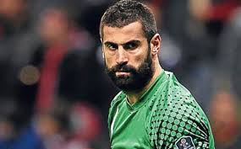

2,5 mill euros x 2,35 = 5,875 mill/year

Slide 24
Now the university tuition rates

Slide 25
Koç Üniversitesi 1998: 6 bin 500 dolar.
Average 1998 exchange rate is 1 USD = 264,000TL
Jan 2 1USD = 207,000TL. Dec 30 1USD = 315,000TL
Tuition 1998 is 1,716,000,000TL
Drop 6 zeros: 1,716TL
Now it is almost 40,000TL
CPI January 1998 : 919 (with 1994 = 100)
CPI January 2013: 18874
1716 x (18874/919)
= 1716 x 20,5
= 35,178TL

Slide 26
Daily Bread
1970 | 620 gr | 1 Lira
1980 | 480 gr | 7,5 Lira
1990 | 320gr | 1000 Lira
2000 | 200gr | 100,000 Lira
2010 | 300gr | 50 krş
2012 | 250gr | 50 krş
In real terms in which year is bread more expensive: 2000 or 2012?

Slide 27
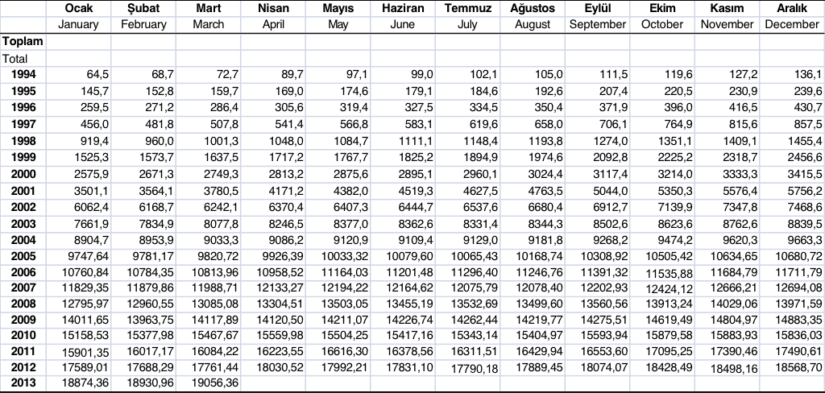
CPI (TÜFE) 1994 - 2013

Slide 28
The last example for “Correcting Variables for Inflation”: Real vs. Nominal Interest Rates
The nominal interest rate:
the interest rate not corrected for inflation
the rate of growth in the TL value of a deposit or debt
The real interest rate:
corrected for inflation
the rate of growth in the purchasing power of a deposit or debt

Slide 29
The 100% correct formula for real interest rate
Real interest rate =
(1 + nominal interest rate) / (1 + rate of inflation) – 1

Slide 30
If the nominal interest rate and the rate of inflation are both small (in the 5 to 10% range),
then we can use the following formula as an approximation:
Real interest rate = (nominal interest rate) – (inflation rate)

Slide 31
Real and Nominal Interest Rates: EXAMPLE
Put 1,000TL in the bank for one year.
Nominal interest rate is 9%.
Yearly inflation is 3.5%.
Real interest rate = Nominal interest rate – rate of Inflation
= 9.0% – 3.5% = 5.5%
The purchasing power of the 1,000TL deposit has grown 5.5%.

Slide 32
Real and Nominal Interest Rates in the U.S.
Notes:
This graph replicates Figure 3 from this chapter. The figure is constructed using quarterly data from the U.S.
The nominal interest rate is the rate on a three-month Treasury Bill. The real interest rate is the same, minus the inflation rate as measured by the percentage change in the CPI.
Notice that the nominal and real interest rates often do not move together, indicating that the real interest rate varies over time.
Sources:
CPI – Bureau of Labor Statistics
Treasury bill rate – Board of Governors of the Federal Reserve System.
I obtained both from the Federal Reserve Bank of St. Louis “Fred” database:
http://research.stlouisfed.org/fred2/

Slide 33
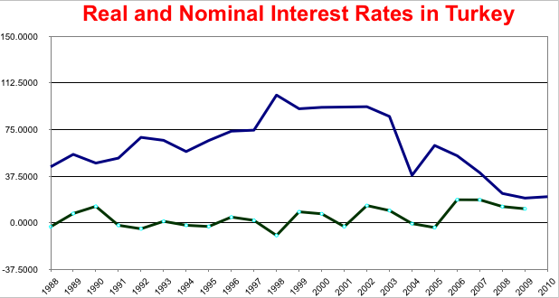

Slide 34
Links between inflation and interest rate
Response to Rising Inflation
If inflation rises, generally, central banks increase interest rates to reduce inflationary pressure.
Higher interest rates tend to reduce consumer spending. This is because homeowners see an increase in the cost of their mortgage payments and have less disposable income. Therefore, they spend less. Also, higher interest rates increase the incentive to save and reduce the incentive to borrow.
Therefore, an increase in interest rates tends to reduce the rate of economic growth and prevent inflationary pressures.
Mechanism: The Federal Open Market Committee (FOMC) meets eight times each year to review economic and financial conditions and decide on monetary policy. Monetary policy refers to the actions taken that affect the availability and cost of money and credit. At these meetings, short-term interest rate targets are determined. Using economic indicators such as the Consumer Price Index (CPI) and the Producer Price Index (PPI), the Fed will establish interest rate targets intended to keep the economy in balance. By moving interest rate targets up or down, the Fed attempts to achieve maximum employment, stable prices and stable economic growth.

Slide 35
Links between inflation and interest rate
Response to Fall in Inflation Rate
If inflation falls below the target, there is likely to be a fall in the rate of economic growth, and central banks may fear a recession. Therefore, in response they may cut interest rates to try and boost economic growth.
Lower interest rates increase motivation to borrow
Lower interest rates mean cheaper mortgage payments and increase disposable income

Slide 36
Links between inflation and interest rate
Other direction
Generally, an increase in inflation, leads to higher interest rates.
A fall in inflation rate, and lower growth leads to lower interest rates.

Slide 37
Inflation in Perspective
Firms layoff workers, leading to an increase in unemployment and wages decrease.
Because wages and prices are sticky, the reduction in spending causes firms to cut back production.
Output
Cyclical Unemployment
Demand
Initially, output is high.
When inflation rises, central banks act to cool the economy.
As unemployment falls, wages increase. This causes prices to increase.
Inflation

Slide 38
Inflation and macroeconomic (in)stability
High inflation discourages investment and growth, thus leading to macroeconomic instability.
According to the IMF data, between 1990-2008, average inflation rate fell in 97 out of 162 countries, compared to the rates in the 1970’s and 80’s. It fell in all of the rich countries. In OECD countries, it fell from 7,9 % to 2,6 %.
A study by Rogoff and Reinhart:
1945-1970: no country in banking crises
1970-1980: ratio of countries with banking crises rose to 5-10 %
mid 1990’s: this ratio shot up to 20 %
mid 2000’s: this ratio fell to zero
following 2008: this ratio went up to 35 %

Slide 39
Inflation and macroeconomic (in)stability
After 1980’s, the free market policies are accelerated:
Low inflation
Greater capital mobility
Greater job flexibility\insecurity

